Slide 1

Corporate (jobs]
Domain & employability skills
Campus

Slide 2
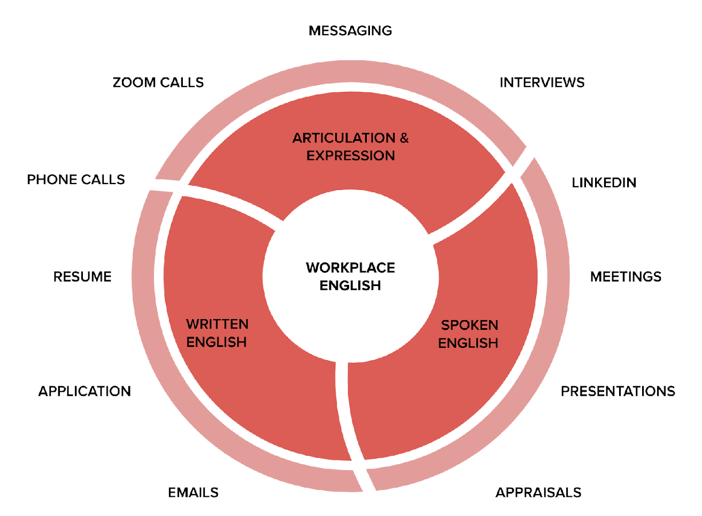
"English Fluency is a key employability skills and it is an Unavoidable Reality in the Workplace."
“Communication is a skill that you can learn. It’s like riding a bicycle or typing. If you’re willing to work at it, you can rapidly improve the quality of very part of your life.”
Brian Tracy

Slide 3
MASAI IS FOR BHARAT,
#1.
#2.
#3.
70% of our students are from Tier 2 / 3 towns
60% of our students have studied in Vernacular medium during high school
70% of our students are from EWS backgrounds
Listening
Reading
Writing
Speaking
Grammar
50 Sprints , 45 minutes per day
Read a curated article that is inspiring and informative
Use your Zoom to record your reading
Time investment of 10 minutes per day x 21 days

Slide 4
3 Powerful Platforms | Tools to build your communication skills and confidence
#1. EFM
#2. MRM
#3. MSM
English Fluency Marathon
Masai Reading Marathon
Masai Speaking Marathon
EFM helps to build your English fluency focussing on the core building blocks
MRM helps to build your pronunciation & confidence
MSM helps you to build your thinking, articulation, fluency & Confidence
Listening
Reading
Writing
Speaking
Grammar
50 Sprints , 45 minutes per day
Read a curated article that is inspiring and informative
Record the video on the LMS
Time investment of 10 minutes per day x 26 days
You speak for 3-5 minutes on a given general topic
Record the video on the LMS
Time investment of 10 minutes per day x 26 days

Slide 5
Guidelines:
Masai Reading Marathon Guidelines: Video Link Here
Masai Reading Marathon Guidelines: Document Link Here
Masai Speaking Marathon Guidelines: Video Link Here
Masai Speaking Marathon Guidelines: Document Link Here

Slide 6


26 / 90
“Creating a habit takes 26 days, and it takes 90 days to integrate it into your persona."

Slide 7


Platform #2 : Masai Reading Marathon
Difficulty level : Low
Completion Certificate : NO
Medium : Masai LMS (Assess)
IS
NOW

Slide 8
What is MRM?
The Masai Reading Marathon (MRM) is a 26-day reading challenge designed to enhance your reading skills and boost your confidence in English.
Each day, you'll read a provided article aloud, focusing on clarity and fluency.

Slide 9
Why Participate?
Expand Your Vocabulary
Improve Reading Comprehension
Enhance Pronunciation & Language Proficiency
Build Consistency

Slide 10
How to Approach the Masai Reading Marathon: 26 Continuous Days
Step 1: Prepare your virtual Setup
Open your MRM assignment on the LMS.
Ensure that your video, audio, and recording settings are turned on.
Step 2: Access the Reading Material
We will provide you with a daily reading article in the assignment
Start the assignment to access the reading material for the day.
Step 3: Engage in Reading Practice
Read the article aloud, focusing on clarity and fluency.
Aim to complete the article or blog within approximately 10-15 minutes each day.
Step 4: Maintain Consistency
Commit to participating in the Masai Reading Marathon for 26 consecutive days.
Dedicate a specific time each day to complete the reading practice.
Step 5: Reflect and Celebrate
On the 27th day, take the time to watch your recorded readings from day 1 and day 26.
Reflect on your progress, observing any improvements in speech and fluency.
Celebrate your achievements and the effort you put into the challenge!
By following these steps and maintaining consistent practice, you can enhance your reading skills, fluency, and confidence. Enjoy the journey of self-improvement throughout the Masai Reading Marathon!

Slide 11


Platform #3 : Masai Speaking Marathon [MSM]
Difficulty level : MEDIUM
Completion Certificate : YES
Content : Access on LMS through daily assignment
Is Now

Slide 12
Season #16
Darr Ke Aage Jeet Hai
डर के आगे जीत है
What is MSM?
Objective : Build your Fluency & Perseverance
Duration: 12.04.2024 to 07.05.2024
Prizes :
Marathon completion Certificate
15+ continuous recordings (Half marathon)
26 continuous recordings (full marathon)
Activity :
Daily 1 Video recording on LMS as per the assignment
Duration 3 minutes (Min) & 5 minutes (Max)
Mandatory: Video On, Audio On

Slide 13
Why Participate?
Improve Spoken English Fluency
Overcome Speaking Anxiety
Develop Critical Thinking
Build Confidence
Boost Articulation

Slide 14
How to Approach the Masai Speaking Marathon: 26 Continuous Days
Step 1: Prepare your virtual Setup
Open your MSM assignment on the LMS.
Ensure that your video, audio, and recording settings are turned on.
Step 2: Access the Topic
We will provide you with a speaking topic in the assignment
Start the assignment to access the topic for the day.
Step 3: Engage in Speaking Practice
Speak about the given topic, focusing on clarity and fluency.
Aim to speak for at least 3-5 minutes each day.
Step 4: Maintain Consistency
Commit to participating in the Masai Speaking Marathon for 26 consecutive days.
Dedicate a specific time each day to complete the speaking practice.
Step 5: Reflect and Celebrate
On the 27th day, take the time to watch your recorded readings from day 1 and day 26.
Reflect on your progress, observing any improvements in speech and fluency.
Celebrate your achievements and the effort you put into the challenge!
By following these steps and maintaining consistent practice, you can enhance your speaking skills, fluency, and confidence. Enjoy the journey of self-improvement throughout the Masai Speaking Marathon!

Slide 15
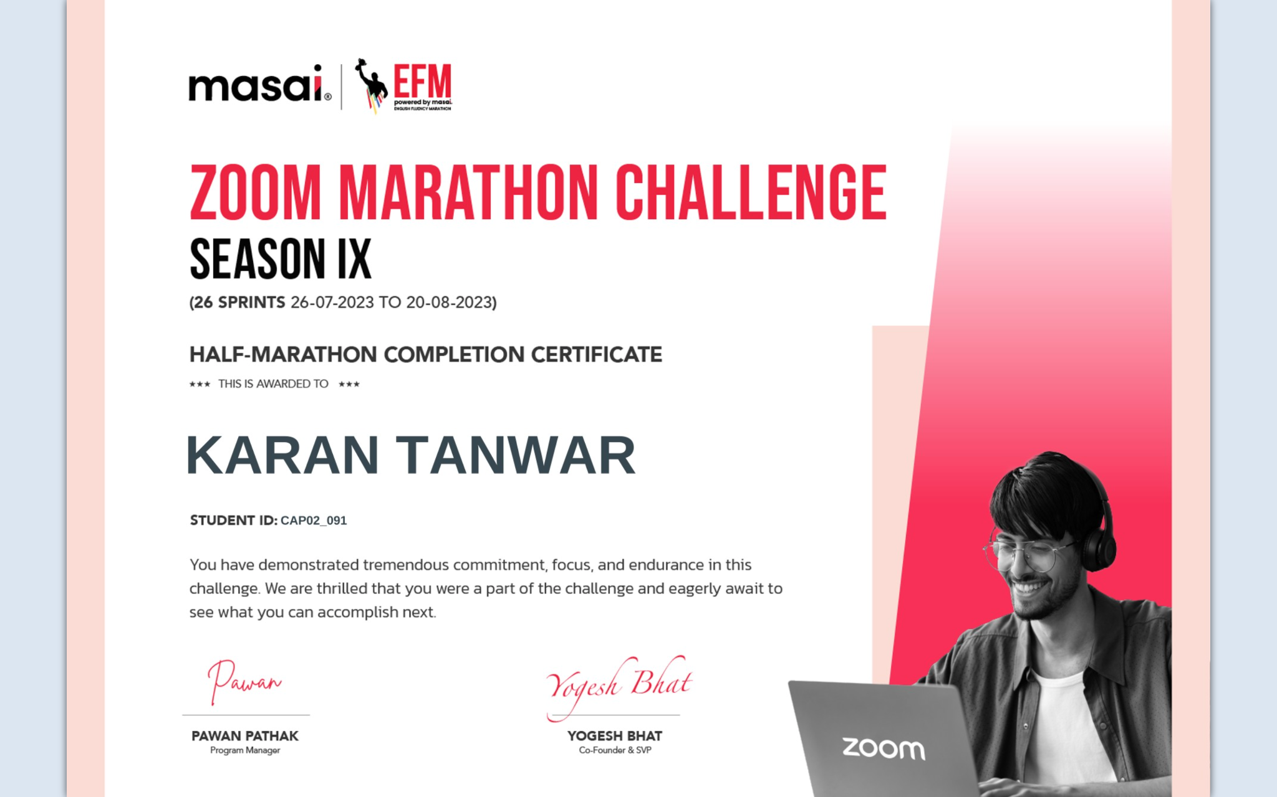
Sample Certificate
You can post this on social media, mention in your resume as proof of perseverance

Slide 16
The EXPECTATIONS:
Active participation
Adhere to the guidelines
Timely Submissions
Joy of progressing
Core Focus:
Reading, Speaking, and Mindset
www.masaischool.com

Slide 17

Students : Complete 3 seasons of MSM and 3 Seasons of MRM, {Eg: Unit 1 - Unit 3 } you will notice a big improvement in your fluency and for some students you will notice a significant transformation
Darr Ke Aage Jeet Hai [डर के आगे जीत है]

Slide 18

YOUR INVESTMENT:
50
50
100
5000
DAYS
SPRINTS
MINUTES PER SPRINT OF TIME
INVESTMENT
MINUTES OF DELIBERATE PRACTICE
Core Focus:
Listening, Reading, Writing, Speaking, Grammar and Mindset
www.masaischool.com

Slide 19


